Slide 1
Effects of GcMAF* on glial cells BV-2
*GcMAF/oleic acid

Slide 2
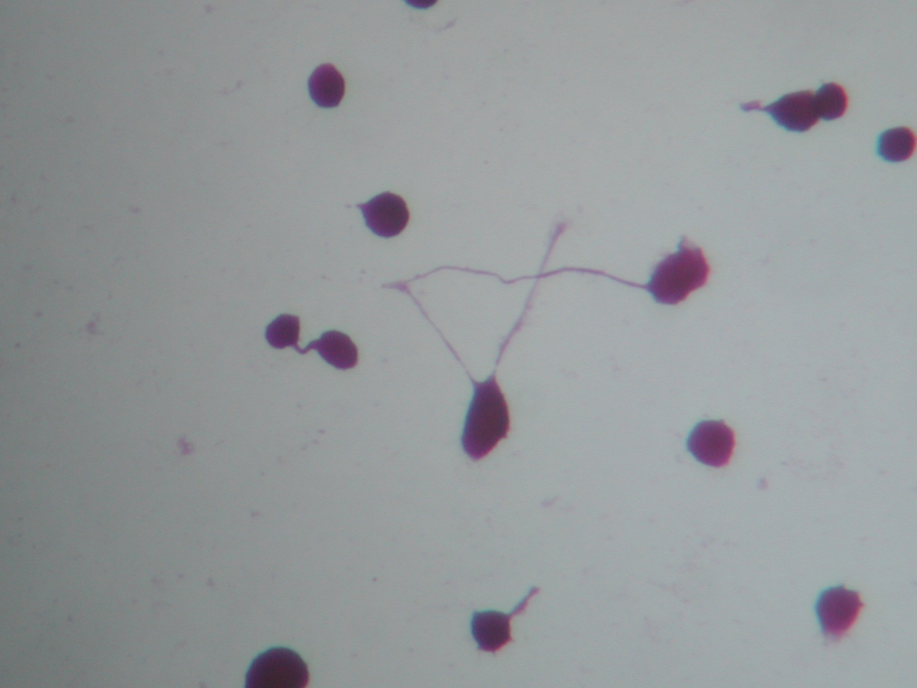
Control

Slide 3
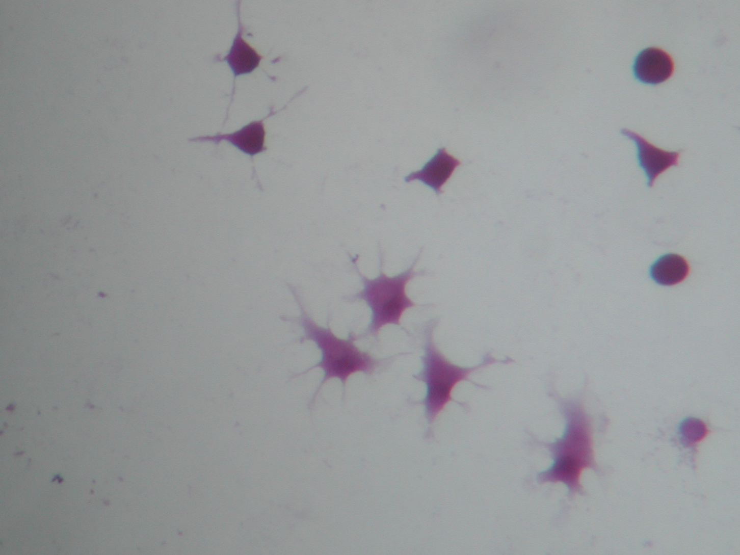
GcMAF, 8 pM, 24h

Slide 4
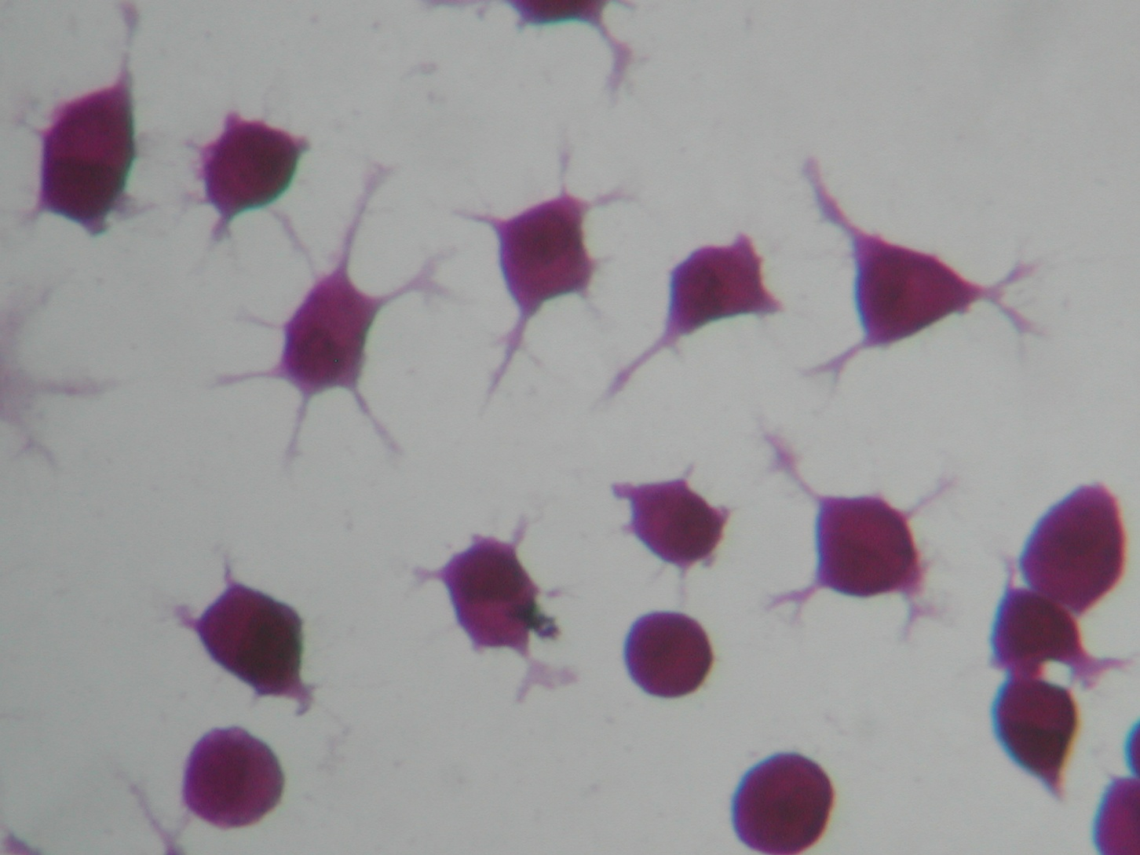
GcMAF, 8 pM, 24h

Slide 5
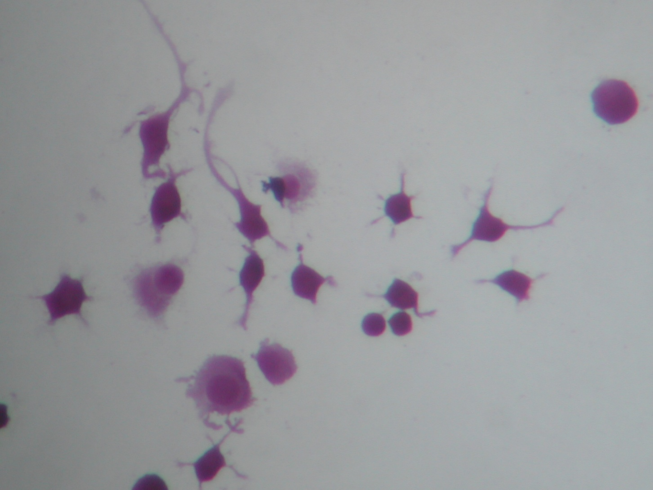
GcMAF, 8 pM, 24h

Slide 6
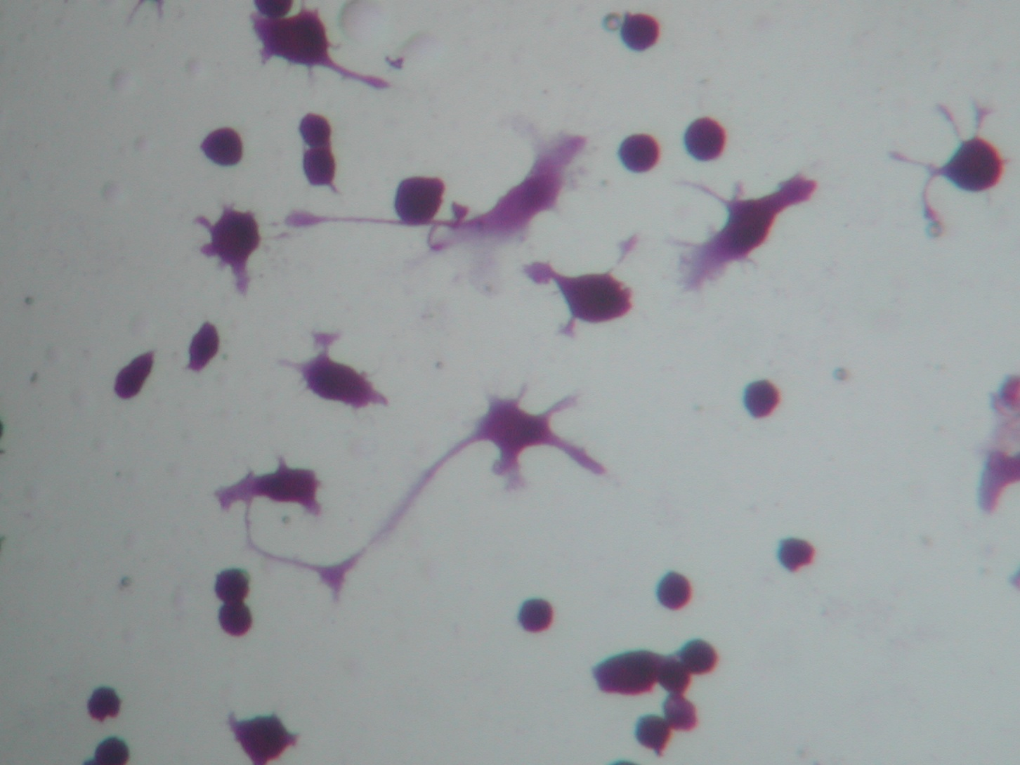
GcMAF, 800 pM, 24h

Slide 7
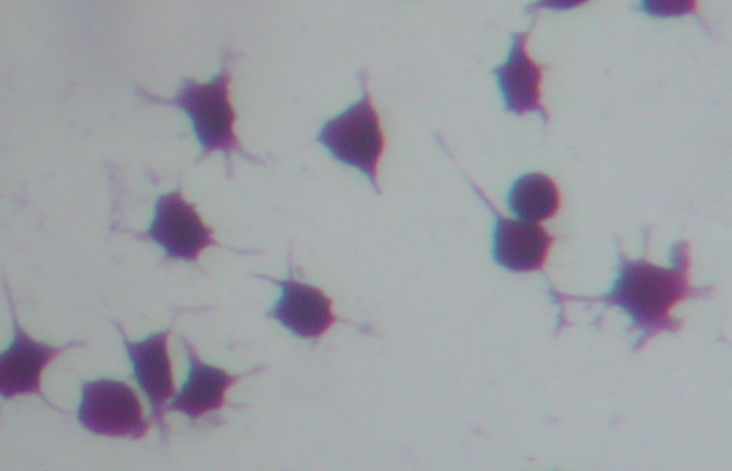
GcMAF, 800 pM, 24h

Slide 8
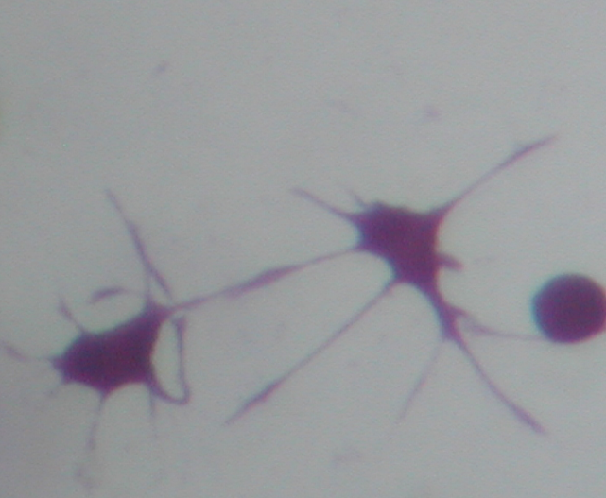
GcMAF, 800 pM, 24h

Slide 9
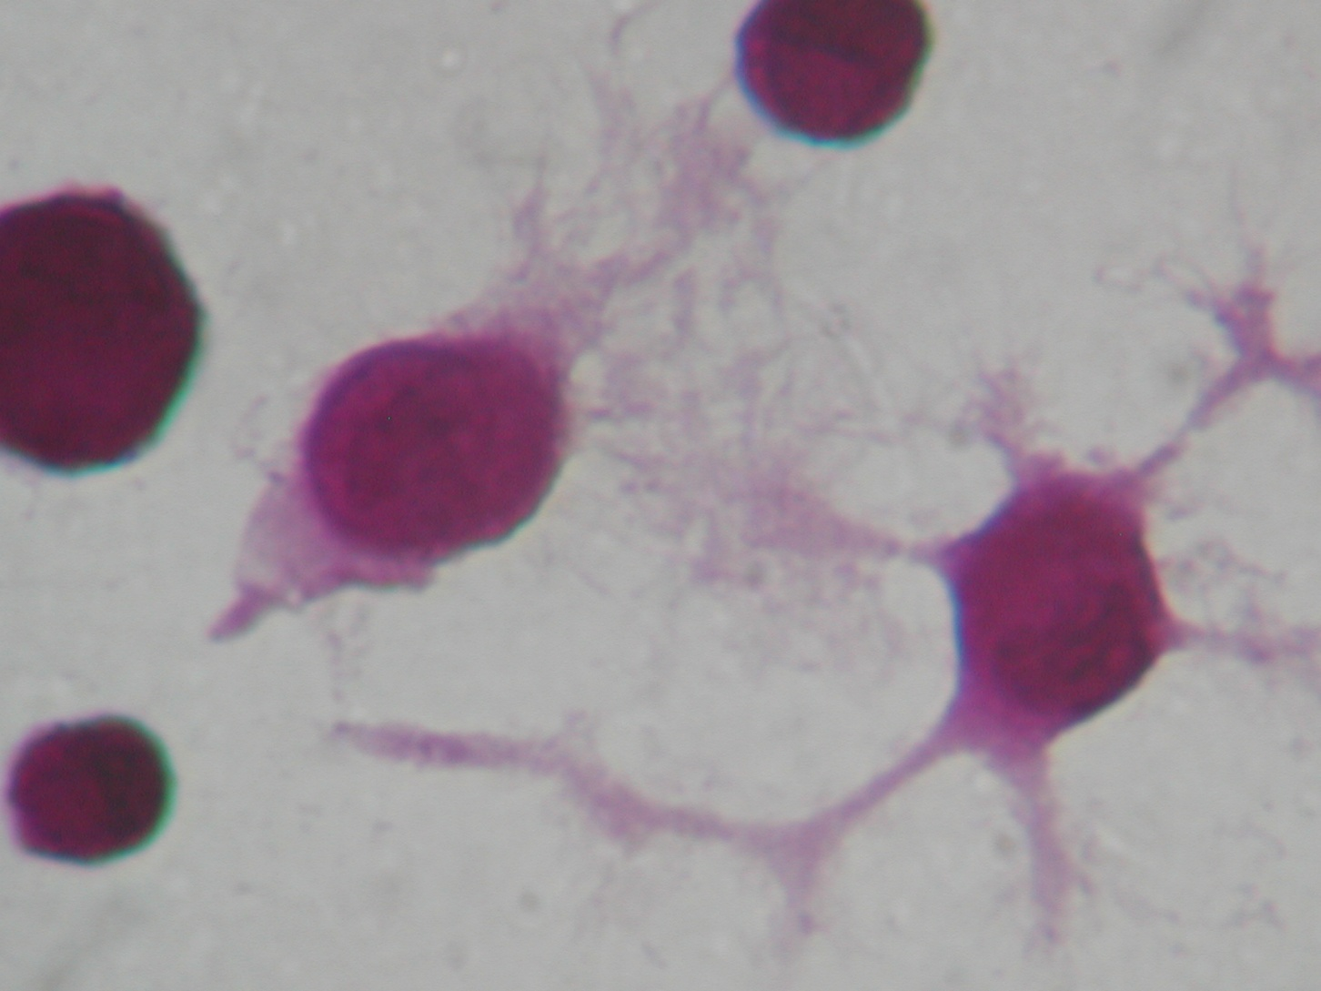
GcMAF, 800 pM, 24h

